Slide 1

Terminal Library Management
Course-time : Phase 1 : Project 01

Slide 2
Requirement Specification
Terminal Library Management
There are three actors in this program, namely,
librarian,
user
and books.
The books will have author, name, publication company, rented date, rented user.
The librarian can add books. The librarian will have fields such as name and contact information.
The user will register in the library by providing his name, contact information The users may take the books for rental. The users will have name, fees and contact details. The user will have registration and login.

Slide 3
Requirement Specification
Design a SQL database with tables users, librarian, books.
Design a menu to
  a) add user, add librarian, add books.
  b) update user details, update books details
  c) delete user, delete books
  d) read the books details and list of books available
  e) perform rental operations
If a book rented date has been updated for two weeks, then the book should be notified to the librarian and user.
If a book is rented out for more than 20 days, fine will be added to the user. The fine will be cumulative after every 5 days after that. eg: After 20 days, the fine will be Rs. 20, after 5 days, it will be 20+25, after another 5 days it will be 20+25+30.

Slide 4
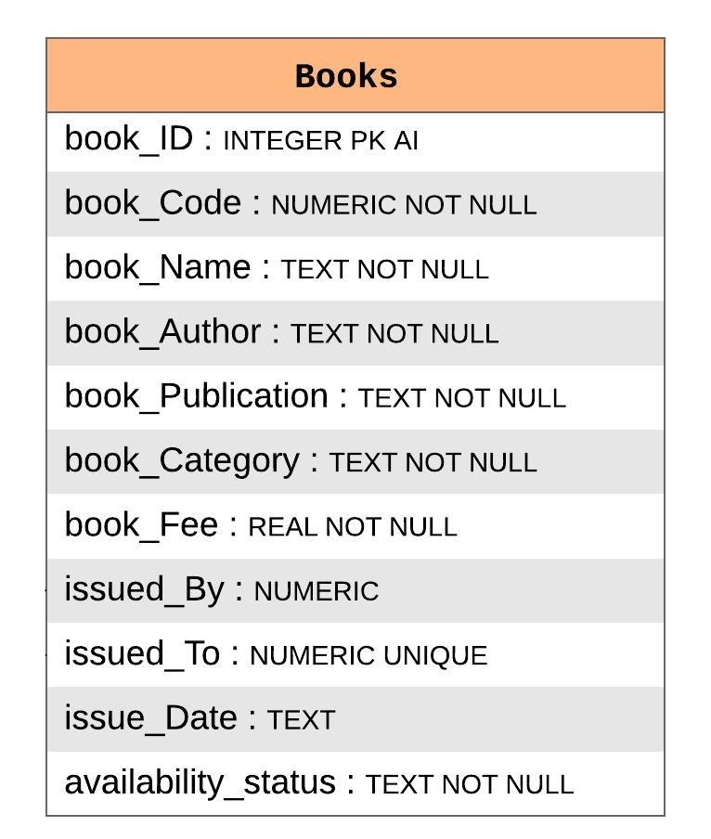
Entities : Book
Fields of a Book :
1
book_ID is an auto-incremented integer value specific to the system. This helps in generating Book Code for a new book that would be added later.
2
book_Code is an alpha-numeric value generated by python with help of book_ID before adding a new book to the system
3
book_Name, book_Author, book_Publication & book_Category are details of a book and are self explanatory.
4
book_Fee is stored as REAL as it would store an amount (that has decimal values)
issued_By & issued_To would be alpha-numeric values as they are the foreign key values of the Librarian & Users’ registration numbers respectively.
5
6
issue_Date would be a text as a date value is stored as text in SQLite
availability_status would represent whether the book is available for rent at the moment. The default value is ‘YES’ as it is obvious that while adding the book to the system for the first time, the book would be available and not rented out yet. There would be no manual updating to this field as the system would handle toggling between ‘NO’/’YES’ as and when the book is rented out or returned.
7

Slide 5
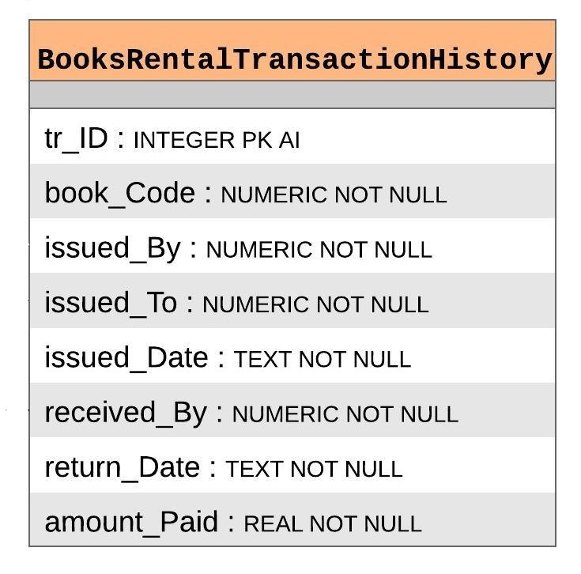
Recording the Transaction History
This table gets populated only on the return of a book that was rented:
1
tr_ID (Transaction ID) is an auto-incremented integer value specific to the system.
2
book_Code is a foreign key value from Books table
issued_By & issued_To would be alpha-numeric values as they are the foreign key values of the Librarian & Users’ registration numbers
3
4
issued_Date would be as per it was issued_Date in Books table before the return of the particular book.
5
received_By would be alpha-numeric values as they are the foreign key values of the Librarian registration numbers
6
return_Date Date of the return of the book by user. (The current date – today()
7
amount_Paid is of REAL type as it stores the amount paid by the user including the fine amount.

Slide 6
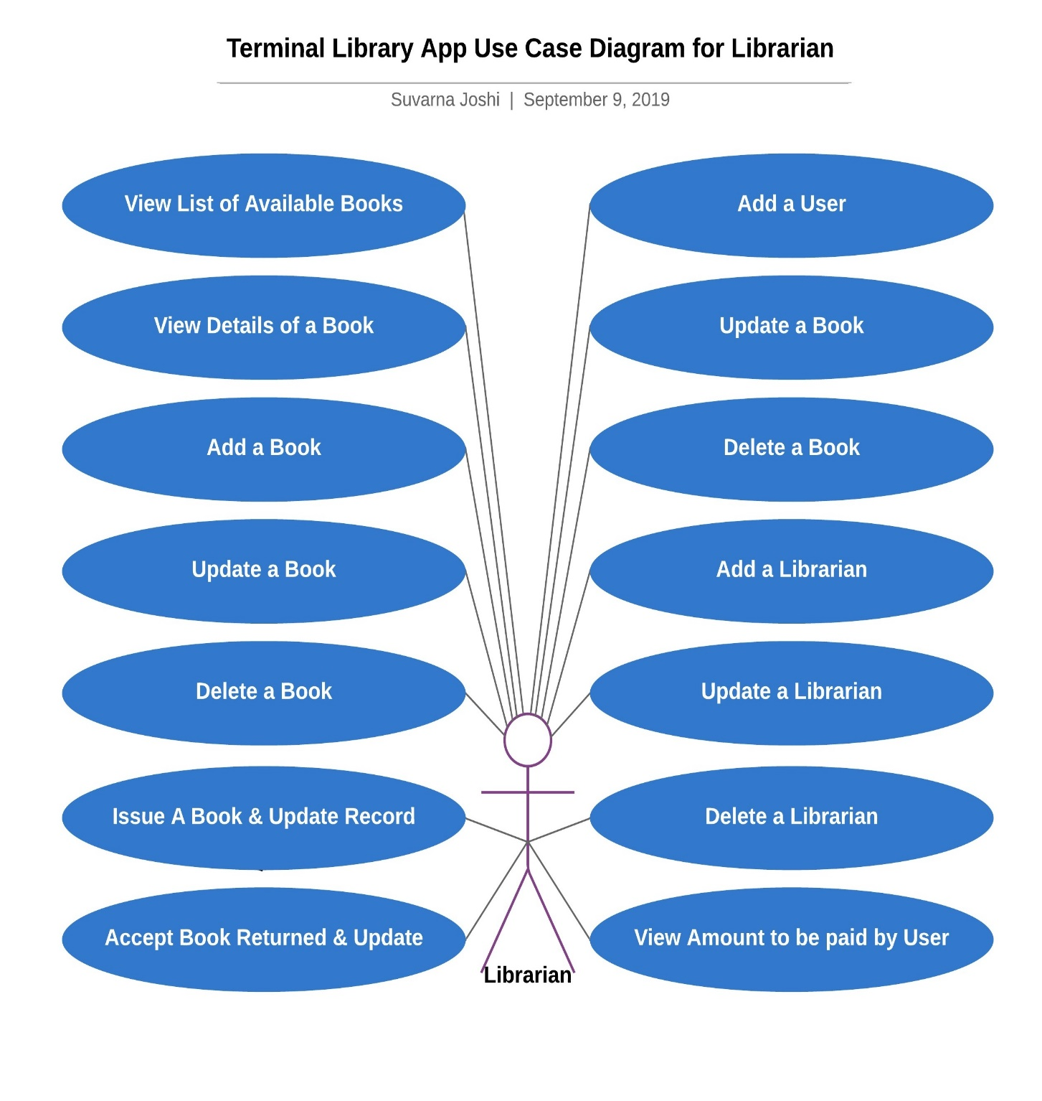
Activities of a Librarian
Options after login:
1
View the List of books in the System that are available for issuing.
2
View Book details of a particular book
3
Add a new Book to the system by providing the required details
4
Update details of a book
5
Delete a book from the system
Issue a book and update details related to the date of issue, issued to & issued by. Book Availability status is set to ‘NO’ once the book is issued..
6
Accept book from User and update details related to the date of return, accepted by & amount paid. Book Availability status is set to ‘YES’ once the book is returned..
7

Slide 7
Activities of a Librarian
Options after login:
8
Add a New User to the system
9
Update the User details
10
Delete a particular User from the system. Their Registration number would be unique forever
11
Add another Librarian to the system
12
Update Librarian details
13
Delete a Librarian. A Librarian cannot delete his own account! The system checks for this and does not allow to do so
View the amount to be paid by the user. The fine amount is calculated based on the requirement as mentioned. The fine amount will be cumulative after every 5 days after the first 20 days
14

Slide 8
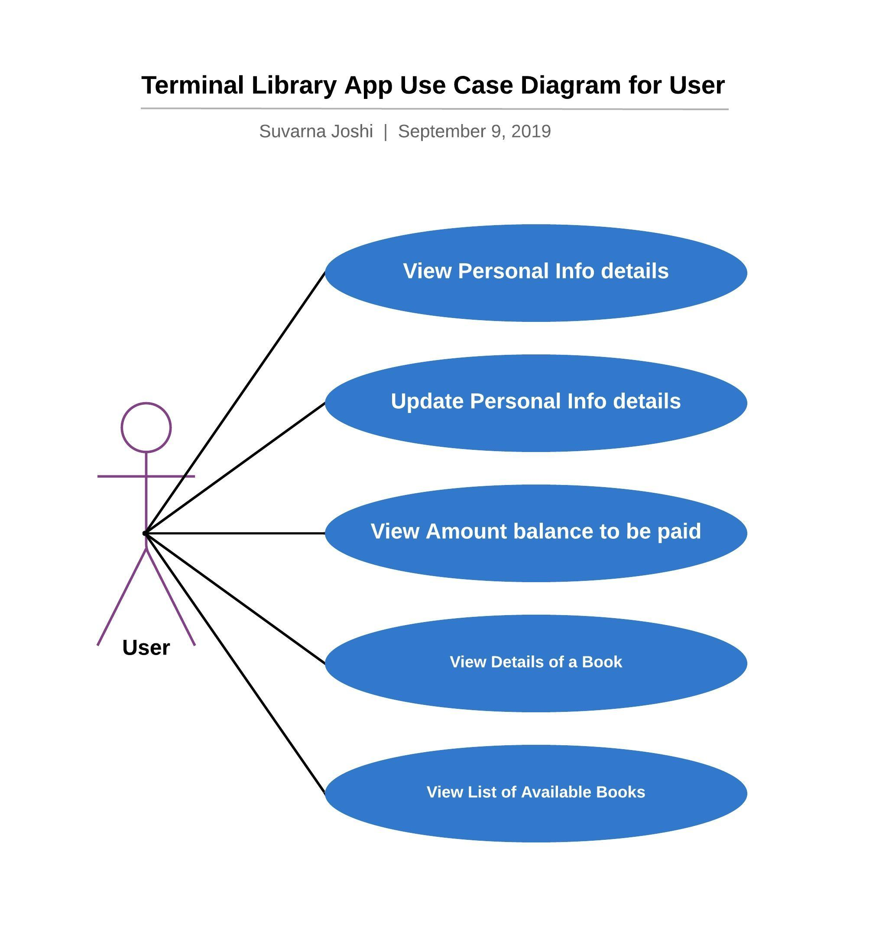
Solution
The execusion for the project start with the login page.
The Login ID & password is entered and the system checks for the validity of the user.
The Login ID is checked for the alphabet it starts with.
If Login ID starts with ‘U’, it would be considered that the User is using the system and login credentials are checked at the Users table in DB.
Valid User would be led to User view page where the User would be able to perform following tasks :
  View list of Books Available in the Library for Rent
  View Details of a particular book
  View the total amount to be paid by self
  View personal info details
  Update personal info details

Slide 9

Solution
If Login ID starts with ‘L’, it would be considered that the User is using the system and login credentials are checked at the Librarians table in DB.
Valid Librarian would be led to Librarian view page where the Librarian would be able to perform following tasks :
  View list of Books Available in the Library for Rent
  View Details of a particular book
  Add a book
  Update book details
  Delete a book
  Issue a book and update details related to issuing of the book
  Accept the book from the user and update details in the system related to the date of return and amount paid

Slide 10
Solution
  Add a New User
  Update User details
  Delete a User
  Add another Librarian
  Update details of a Librarian
  Delete a Librarian
  View amount to be paid by the User including the fine applicable based on the calculations as mentioned below :
  If a book is rented out for more than 20 days, fine will be added to the user. The fine will be cumulative after every 5 days after that. eg: After 20 days, the fine will be Rs. 20, after 5 days, it will be 20+25, after another 5 days it will be 20+25+30.

Slide 11
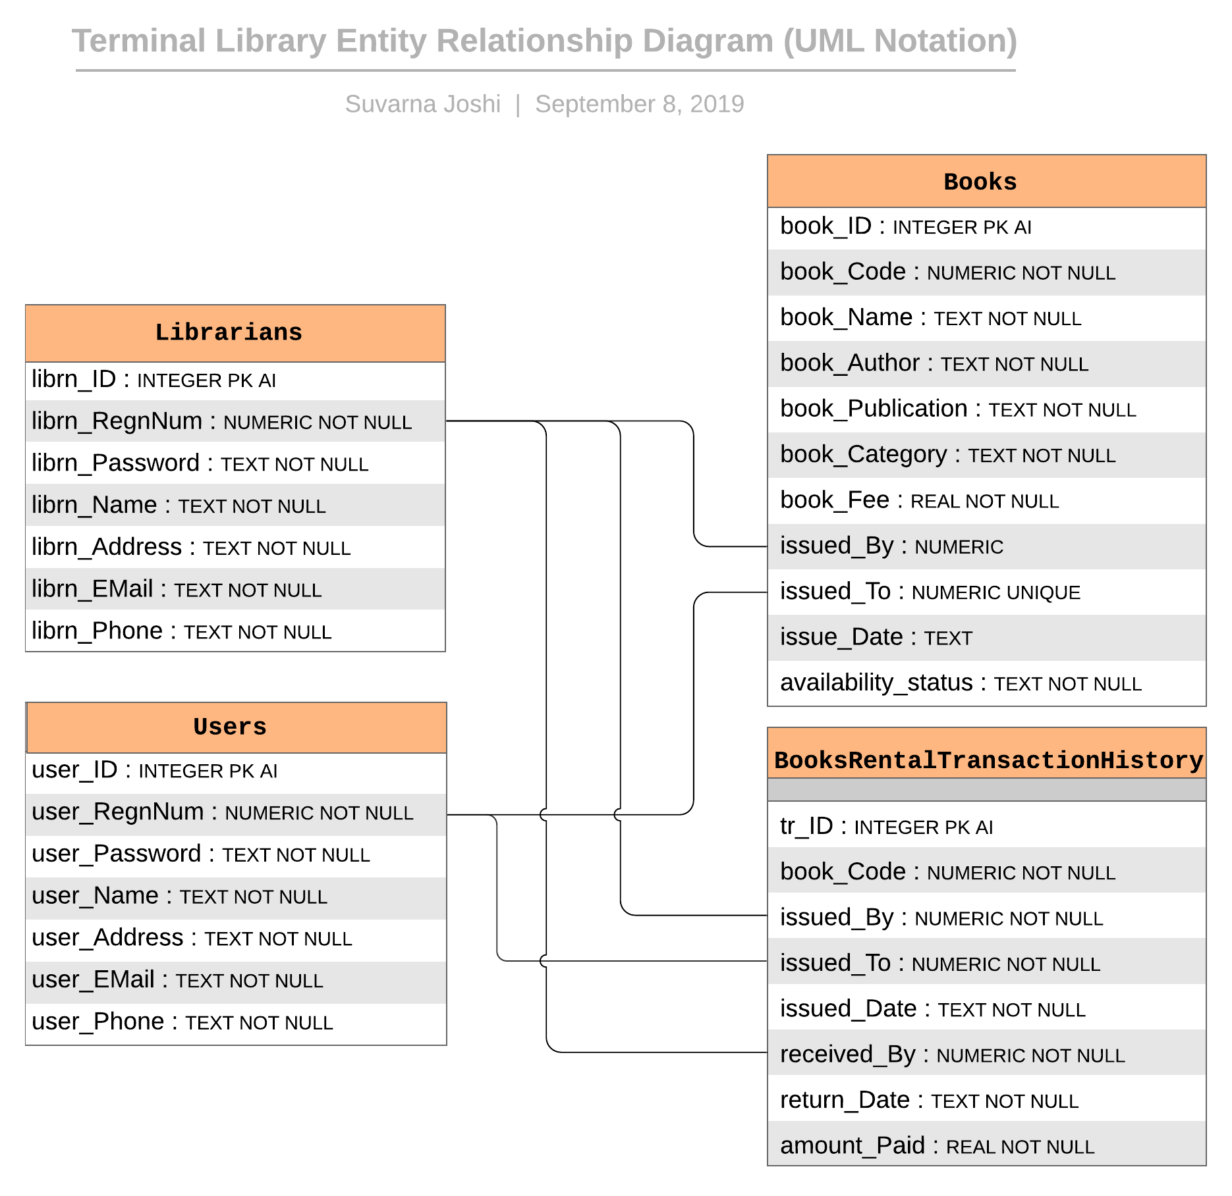
SQL Queries/Statements used
CREATE TABLE IF NOT EXISTS Users (
"user_ID" INTEGER PRIMARY KEY AUTOINCREMENT,
"user_RegnNum“ NUMERIC NOT NULL UNIQUE,
"user_Password" TEXT NOT NULL,
"user_Name" TEXT NOT NULL,
"user_Address" TEXT NOT NULL,
"user_EMail" TEXT NOT NULL,
"user_Phone" TEXT NOT NULL
);

Slide 13
Key Assumptions made in the project
Some keywords cannot be used as login ID / Password
Those listed in ['F$P$', 'admin$', 'EXIT$, LOGOUT$, MENU$, L$]
All users' Registration ID starts with 'U' followed by 9 characters
All librarians' Registration ID starts with 'L' followed by 9 characters
Registration ID and the Book Code are generated by fetching the last record from the table adding 1 to the integer part and adding a suffix of 'U’ or ‘L’ or ‘B’ based on Users table or Librarians table or Books table respectively.
All Book code starts with ‘B' followed by 9 characters

Slide 14
Some Key Assumptions made in the project
First item of the response list would indicate certain type of responses
Code 1 : Success (or True) # On success, the next item list would hold the successful object/list
Code 0 : Failure (or False)
Code 99 : Invalid entry/value to variable
Code 100 : Exception occured
Terminal messages are grouped into many categories/types.
Some may be enabled only when the DEBUG_MODE is set to true
They are :
[WELCOME] - Displays only first time when the user logs in
[MESSAGE] - Messages displayed to the user
[INPUT] - When terminal cursor is waiting for the input from user
[EMPTY] - If any expected input/object is null or empty
[ERROR] - If any unexpected error occurs
[EXCEPT] - When an exception occurs (When an exception is caught by the program)
[DEBUG] – Displays messages only when the DEBUG_MODE is on

Slide 15
Triggers
/***
CREATE TRIGGER on_delete_set_default_Librarian AFTER DELETE ON Librarians BEGIN
UPDATE Books SET issued_By = (SELECT min(librn_RegnNum) FROM Librarians) WHERE issued_By = old.librn_RegnNum;
END;
DROP TRIGGER on_delete_set_default_Librarian;
***/
If in case a Librarian is deleted from the system, then this trigger would consider the last librarian in the list of librarians and update the record in Books table.

